Slide 1
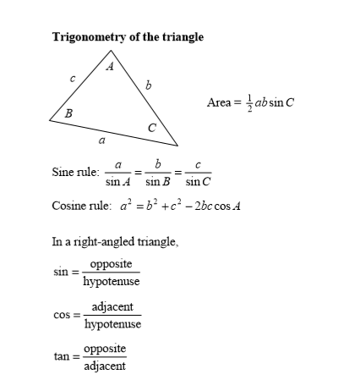

Slide 2
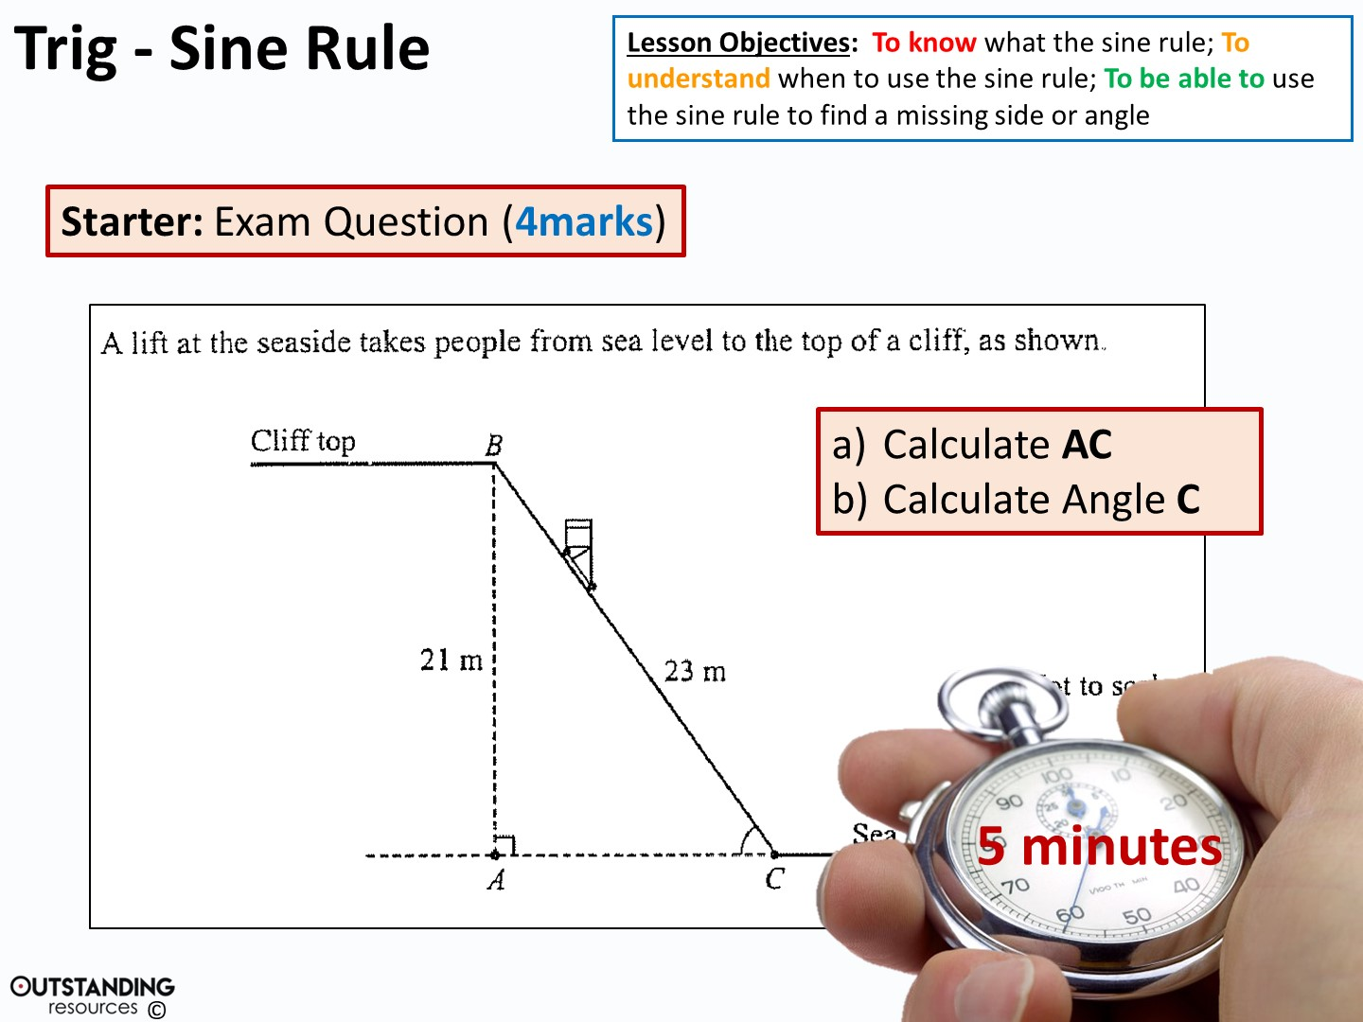
AC = 9.38m (3.s.f.)
<ACB = 65.9° (3.s.f.)
Notes:
Stop watch: taken from - https://www.flickr.com/photos/133046299@N03/26065725796/in/photolist-FHkEas-owcyQq-x7CFfr-NEDYNn-vBvpcX-65m1aJ-BPkRi8-PmYqqh-ziYXty-D2Mg3V-2exsSB-AZDGsA-x5eKg9-Hx9qQg-GBx2m9-9RSt1J-Hub933-KxnKih-vVKasq-Hx9pwe-Hx9qki-KWkMs7-KeaLNj-x5JTnA-CK9UVZ-KMnzv1-c2LFqN-awKby9-dcY8Sx-Ub6a2m-VqtSuF-d8EYR5-vB7KDq-xVExkw-enDhSt-BTMt8K-rQVH5i-w9BQsg-5sBuSW-wNUiHq-4fsVw-xmRcGg-9n7U7e-JR4v8C-wNUwhy-AJegJa-31fb1T-JXjse1-jRrEbV-x5JTTA/ http://creativecommons.org/licenses/publicdomain/

Slide 3
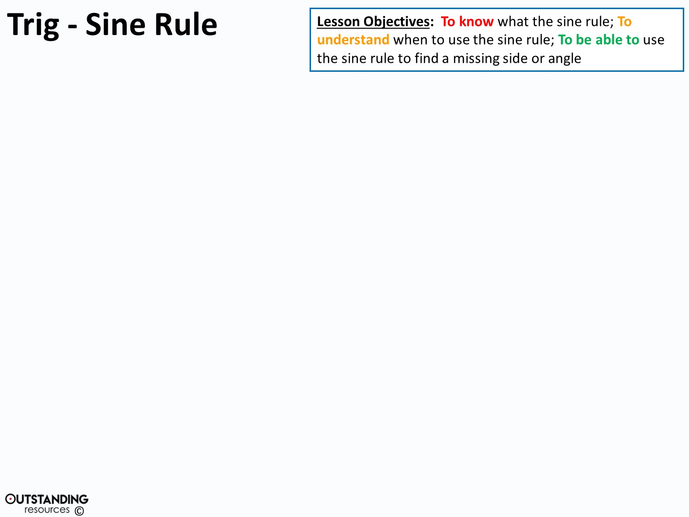
Is it a right angled triangle?
YES
NO
NO
Does it involve an angle?
NO
Does it involve 2 angles?
YES
YES
“Basic” Trig:
(Soh/Cah/Toa)
Pythagoras
Trig:
Sine Rule
Trig:
Cosine Rule

Slide 4
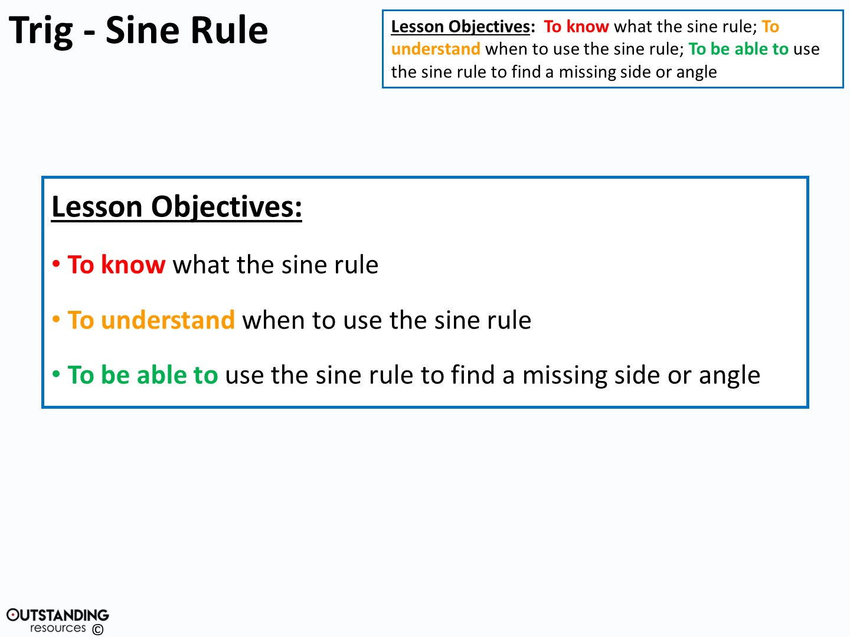

Slide 5
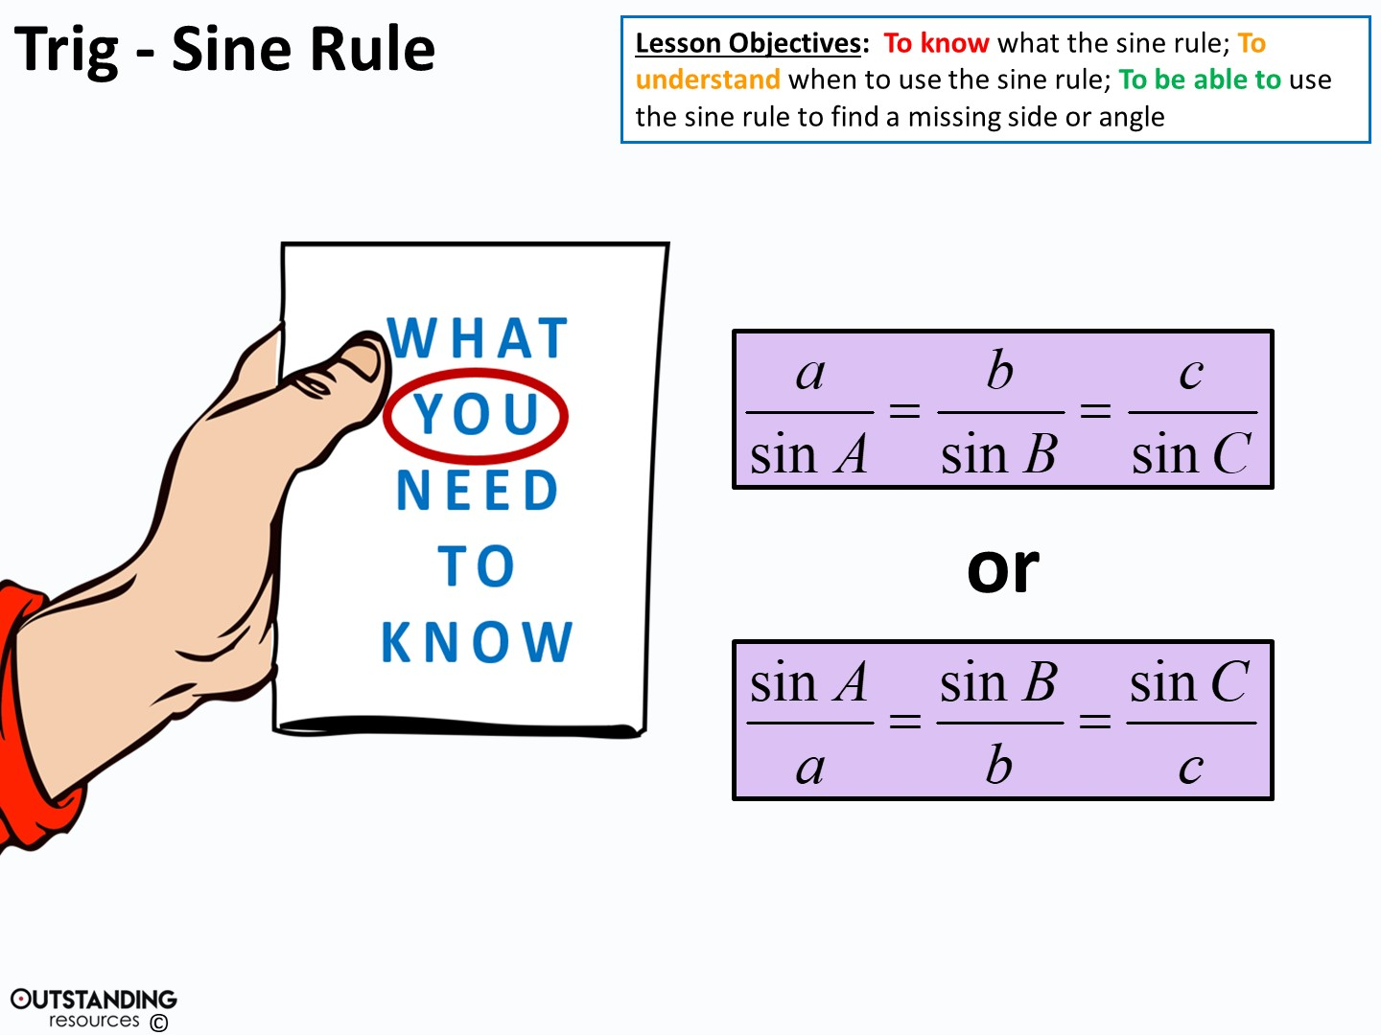
Notes:
Clipart – hand holding brochure : taken from - https://openclipart.org/detail/742/hand-holding-brochure http://creativecommons.org/licenses/publicdomain/

Slide 6
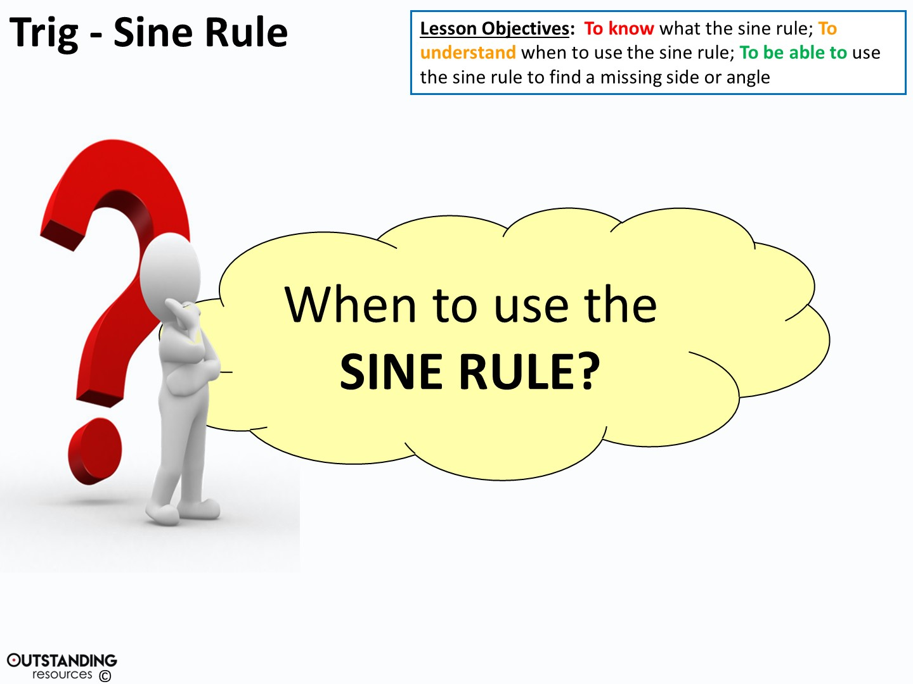
= When you have: 2 sides and 1 angle OR 1 side and 2 angles
Notes:
Clipart – Questions Clipart #29226: taken from - http://clipartix.com/questions-clipart-image-29226/

Slide 7
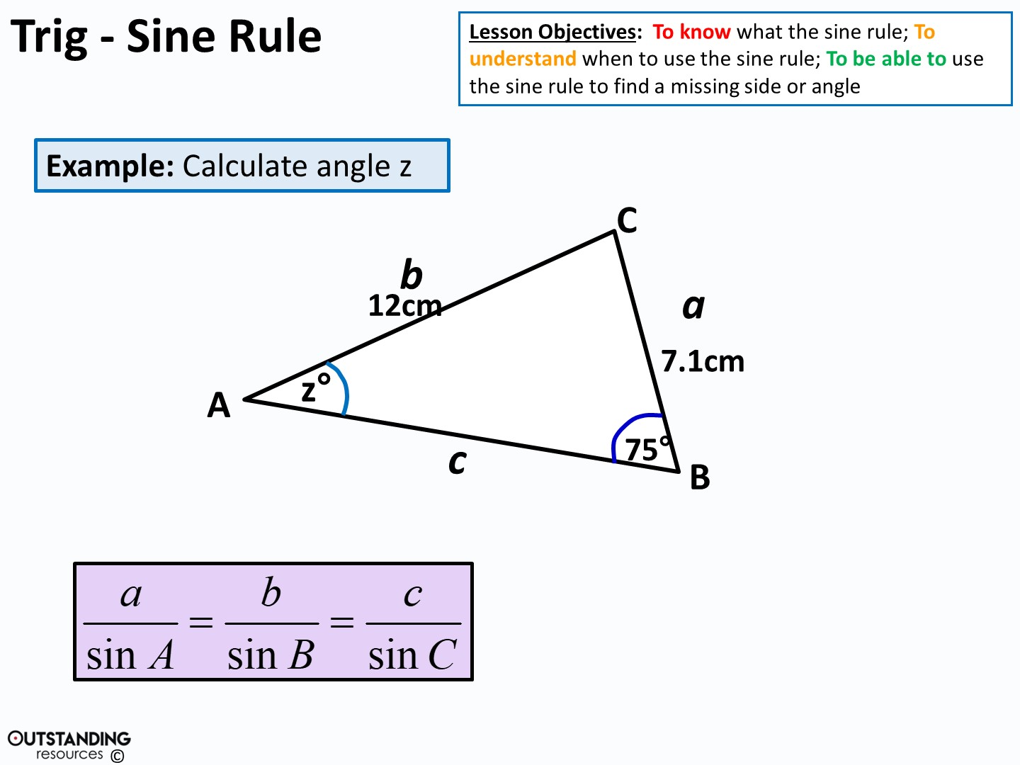
7.1 12
sin z° sin75°
=
=

Slide 8
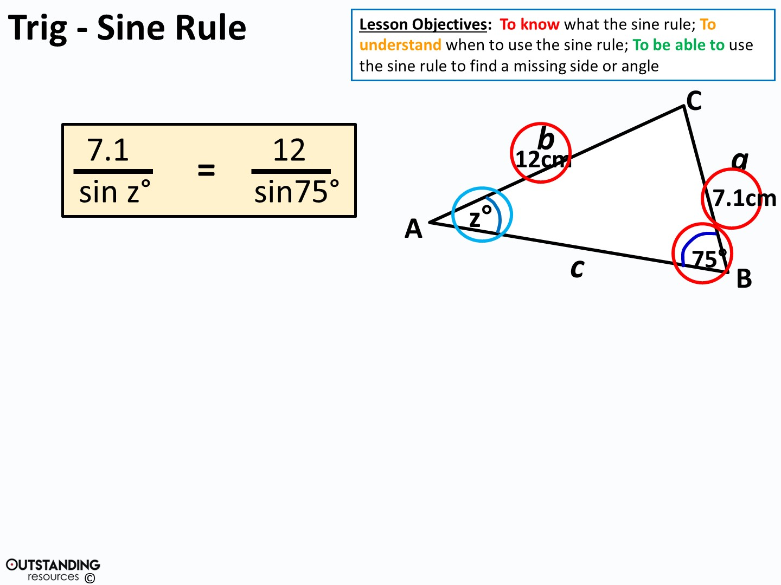

7.1
sin z°
=
12.4233 …
7.1
12.4233 …
7.1
12.4233 …
=
=
sin⁻¹
sin z°
z°
z = 34.9° (to 1.d.p)

Slide 9
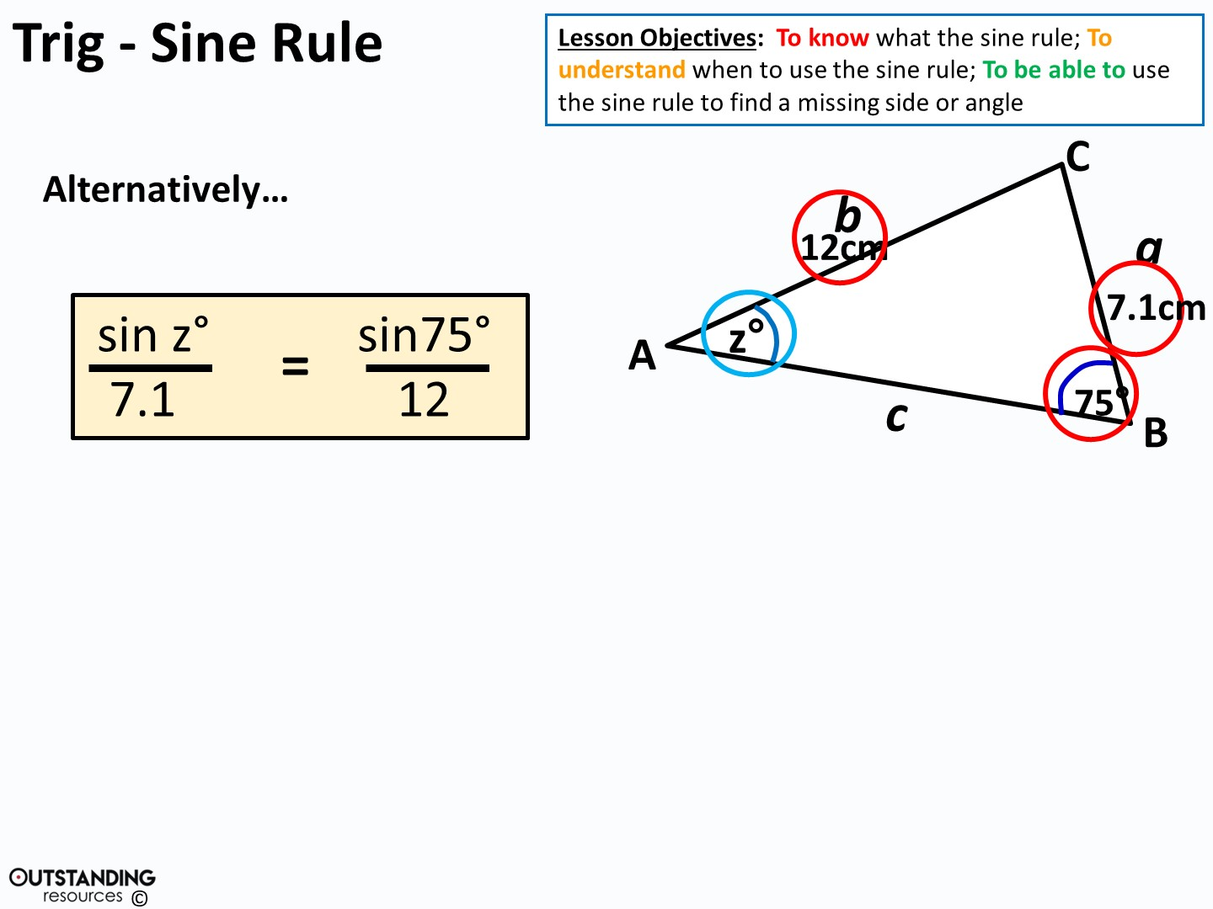
sin z°
7.1
=
0.08049 …
z = sin⁻¹ (0.570849…)
sin z°
=
0.08049 x 7.1
z = 34.9° (to 1.d.p)

Slide 10
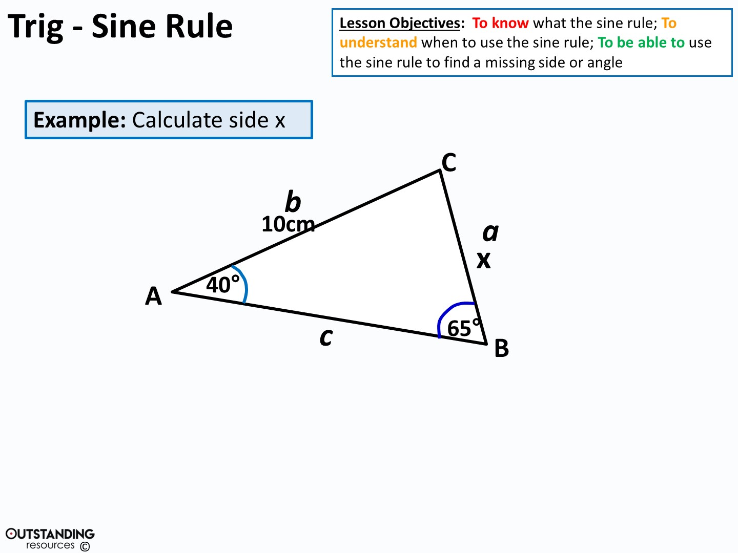
x 10
sin40° sin65°
=
=

Slide 11
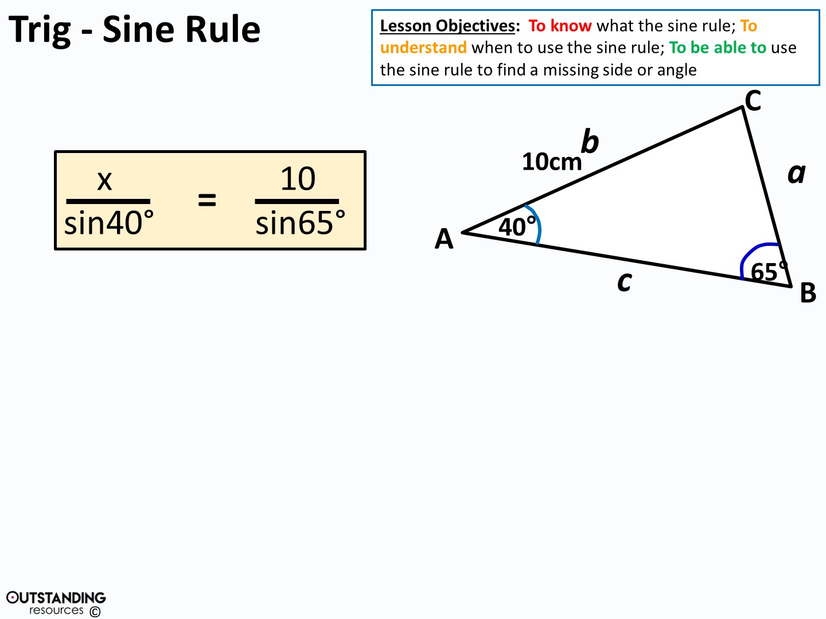
x
sin40°
=
11.033779…
x = 11.033779… x sin40°
x = 7.09 cm (to 3.s.f.)

Slide 12
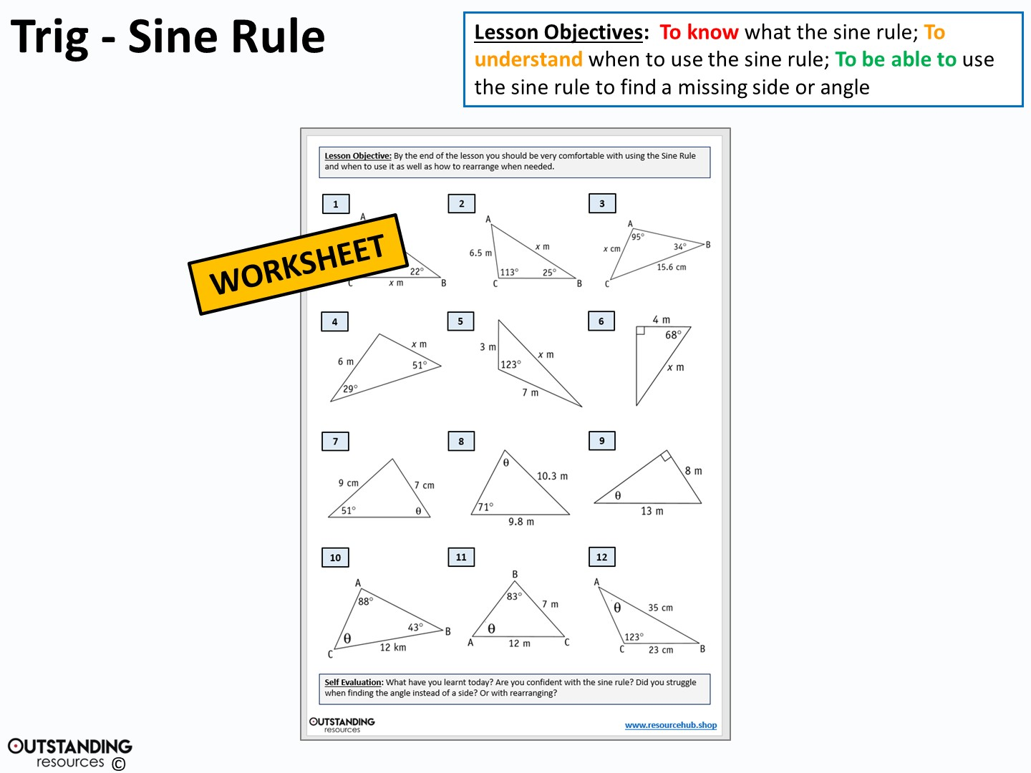

Slide 13
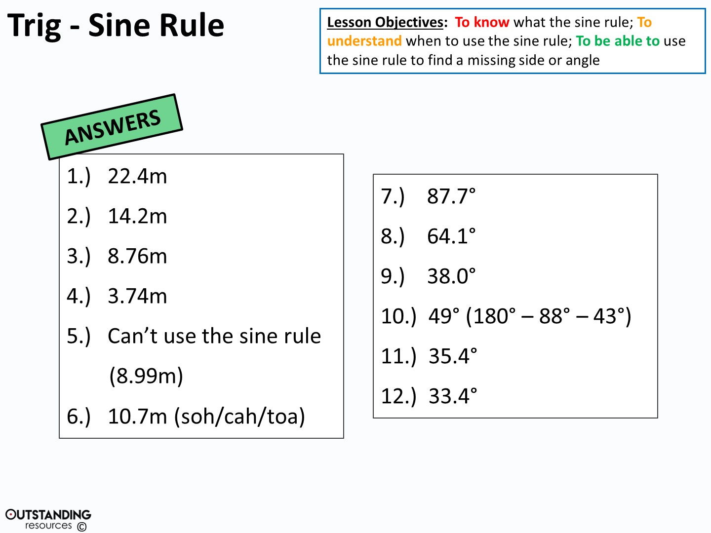

Slide 14
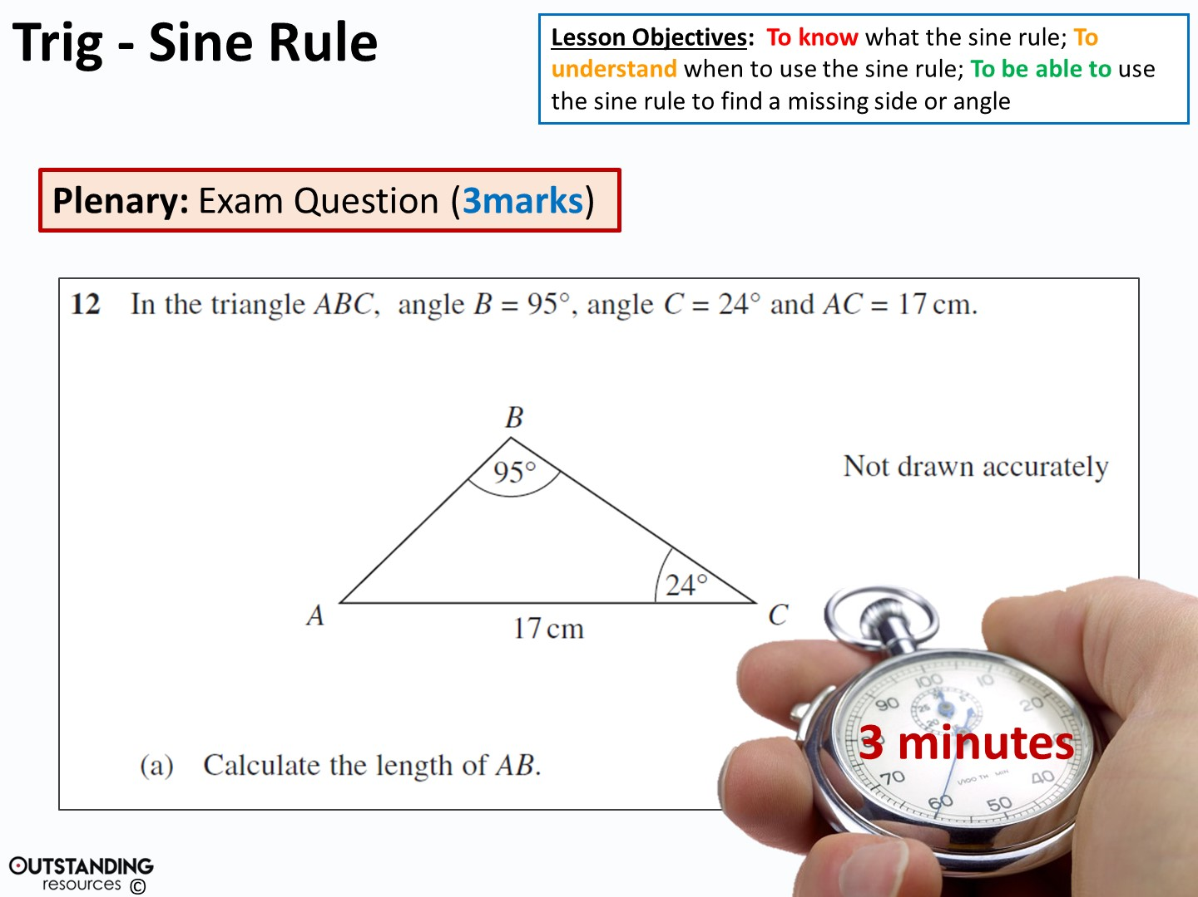
6.94cm (3.s.f.)
Notes:
Stop watch: taken from - https://www.flickr.com/photos/133046299@N03/26065725796/in/photolist-FHkEas-owcyQq-x7CFfr-NEDYNn-vBvpcX-65m1aJ-BPkRi8-PmYqqh-ziYXty-D2Mg3V-2exsSB-AZDGsA-x5eKg9-Hx9qQg-GBx2m9-9RSt1J-Hub933-KxnKih-vVKasq-Hx9pwe-Hx9qki-KWkMs7-KeaLNj-x5JTnA-CK9UVZ-KMnzv1-c2LFqN-awKby9-dcY8Sx-Ub6a2m-VqtSuF-d8EYR5-vB7KDq-xVExkw-enDhSt-BTMt8K-rQVH5i-w9BQsg-5sBuSW-wNUiHq-4fsVw-xmRcGg-9n7U7e-JR4v8C-wNUwhy-AJegJa-31fb1T-JXjse1-jRrEbV-x5JTTA/ http://creativecommons.org/licenses/publicdomain/

